Slide 1
The Market Module
This section will introduce you the market simulation module.

Slide 2
What is the market module?
Integrates a seller/buyer price interaction and resolution capability
Provides an auction object to resolve clearing prices for supply and demand
Provides basic function to submit bids for services or demands into the market

Slide 3
Market – Basic Idea
Bids submitted by two primary types
  Suppliers – bid in amount they can provide and what they want to charge for it
  Demanders – bid in amount they wish to use and how much they are willing to pay for it
Market closes and “clears”
  Bidding process is stopped
  Supply and demand bids are arranged
  Meeting point of the two curves is the “clearing price and quantity” of the auction

Slide 4
Market – Simple Example
Consider a generation and demand scenario
  Generator A can produce 3 kW-h for $0.50 / kW-h
  Generator B can produce 1.5 kW-h for $0.90 / kW-h
  Load A wants 2.5 kW-h for a max of $0.60 / kW-h
  Load B wants 1.0 kW-h for a max of $0.80 / kW-h
What’s the final market clearing price and quantity?

Slide 5
Market – Simple Example
Generation
Bid into the Market
Load
P
2
P
1
1
P
2
Q
Q
Q
Clear the Market
Final Clearing Price and Quantity
P
P
Q
Q
Notes:
This slide is animated! See its awesomeness!

Slide 6
Market – How can it clear?
Discrete buying and selling blocks lead to four general cases for clearing the market
  Dependent upon the cross-over behavior of the discrete buying and selling blocks.
  Variety of special cases can be classified within the general cases.
  Some specific cases may lead to an irresolvable market.
  Buying bids are sorted by descending price, while selling bids are sorted ascending.
  Cases may contain various levels of responsive and non-responsive load.
Additional “special” cases are accounted for

Slide 7
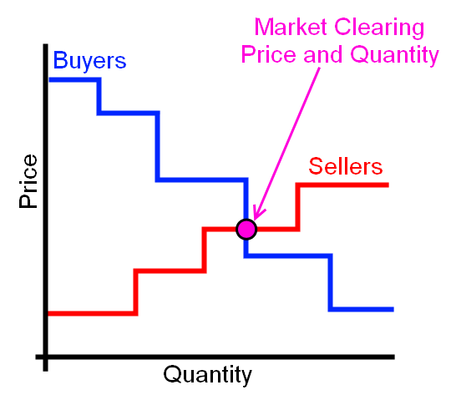
Market – How can it clear?
Marginal Seller case

Slide 8
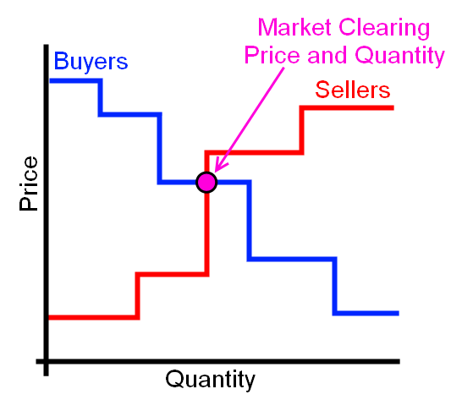
Market – How can it clear?
Marginal Buyer case

Slide 9
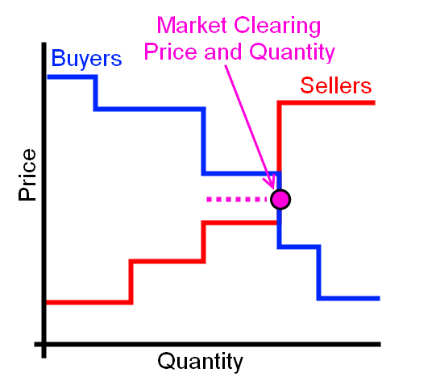
Market – How can it clear?
Seller and Buyer Quantity equal
P_{clear} = ½ * (Bid_{seller} + Bid_{price})

Slide 10
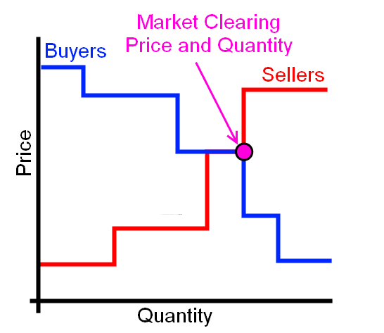
Market – How can it clear?
Seller and Buyer Quantity and Price equal

Slide 11
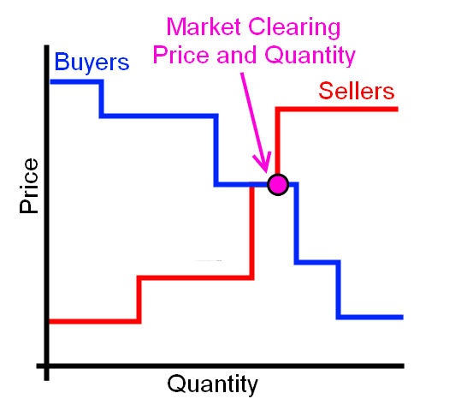
Market – How can it clear?
Marginal Buyer - special case

Slide 12
Market Objects
Auction object
  Collects and processes bids
  Clears market price and quantity
  Measures and stores market statistics
Controller objects
  Interface with loads and generators
  Performs bid and price response functions
  Contains various control methods

Slide 13
Auction Objects
object auction {
string name;
string unit; //i.e. MW, kW, or kWh
integer period[s]; //Interval between market clearings
integer latency[s]; //Lag between clearing and delivery
string special_mode; //Allows for buyer or seller only
double pricecap; //Maximum bid price allowed
boolean verbose; //Allows user to watch bidding
double init_price; //Used to “bootstrap” market if warmup=TRUE
double init_stdev;
object capacity_reference_object; //more details following
integer warmup; // 1=TRUE, 0=FALSE
}
Defines market intervals
Provides clearing price and quantity after clearing, average prices, and standard deviation
Allows for active bidding from buyers and sellers
Also available – previous and current market clearing statistics such as marginal quantity, marginal load, etc.

Slide 14
Auction Objects
The statistical interval desired must be created by the user in the following form:
  class auction {
  double yyyy_price_mean_xx;
  double yyyy_price_stdev_xx;
  }
Where “yyyy” can be “current” or “past” and “xx” can be “#m”, “#h”, “#d”, or “#w”:
  class auction {
  double past_price_mean_5d;
  double current_price_stdev_3m;
  }
Any number of statistics can be created and used by various objects

Slide 15
Auction Objects
Available auction outputs:
  user specified statistics
  current_market.clearing_price
  current_market.clearing_quantity
  past_market.clearing_price
  past_market.clearing_quantity
  clearing case type

Slide 16
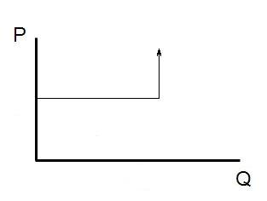
Capacity Object
Acts as a selling agent to limit power flowing through object (or other properties)
If below capacity, market should clear at bid price
If at/above capacity, should clear to limit quantity
Seller bid is a user-defined quantity and typically an RTP price signal
Buyer bid is the estimate of the unresponsive load as the quantity and price cap
to pricecap
Seller bid
Load bid
Unresponsive load
Responsive or bidding load

Slide 17
Example Capacity Object
object auction {
name Market_1;
type DOUBLE;
unit kW;
period 300;
// Initial statistics to stabilize initial market
init_price 35.0001;
init_stdev 10;
warmup 1;
// looking at the feeder regulator and power flowing through
capacity_reference_object 1406_regulator;
capacity_reference_property power_out_real;
capacity_reference_bid_price seller1*1;
max_capacity_reference_bid_quantity 125; //kW
}

Slide 18
Auction Objects
object stubauction {
string name;
string unit;
integer period[s];
boolean verbose;
enumeration control_mode;
double current_market.clearing_price;
}
Defines market intervals
Provides clearing price averages, and standard deviations at 1, 3, and 7 day intervals (new implementation will allow user to specify any interval).
Provides a static, non-biddable price signal

Slide 19
Bidding Function
Once an auction has been established, objects can submit bids
submit_bid function structure
  Market to bid into
  Object that is bidding
  Quantity to bid
  Price of bid

Slide 20
Clearing of the Market
Previous values stored in past_market.clearing_price and past_market.clearing_quantity
Current cleared values stored in current_market.clearing_price and current_market.clearing_quantity
Output values can be seen via recorder or directly delivered to a controller object

Slide 21
Controller Objects
object controller {
string control_mode; //RAMP or DOUBLE_RAMP
string market; //Name of auction object to be used
string parent; //Object modified by controller
string setpoint; //Set point to be modified by controller
string base_setpoint;//Desired set point value
string target; //Value set point is compared against
integer period[s];
string demand; //Bid quantity of object
boolean verbose;
string bid_mode;
string simple_mode; //Various “easy” connections to appliances
property average_target;
property standard_deviation_target;
…
}
Provides an interaction point between loads and market.
Uses various external inputs to determine a bid_quantity and bid_price for the object it is attached to.

Slide 22
Controller Objects - Ramp
object controller {
…
control_mode RAMP;
double range_low;
double range_high;
double ramp_low;
double ramp_high;
double slider_setting_heat; //Simple pre-set slider 0-100%
double slider_setting_cool; // for participation in market
}
Control mode is dependent upon the object to be controlled.
Determines how the object bids and how it responds to a specific price.
RAMP mode controls thermostatic set points.

Slide 23
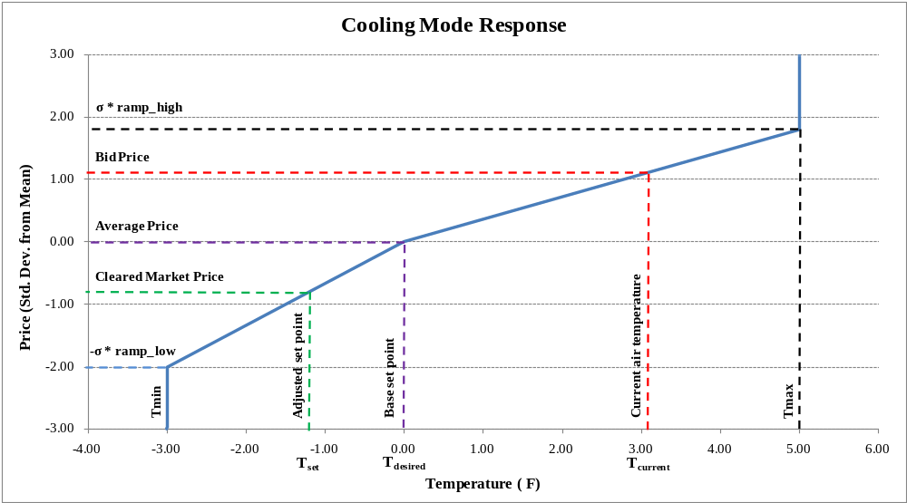
Controller Objects - Ramp

Slide 24
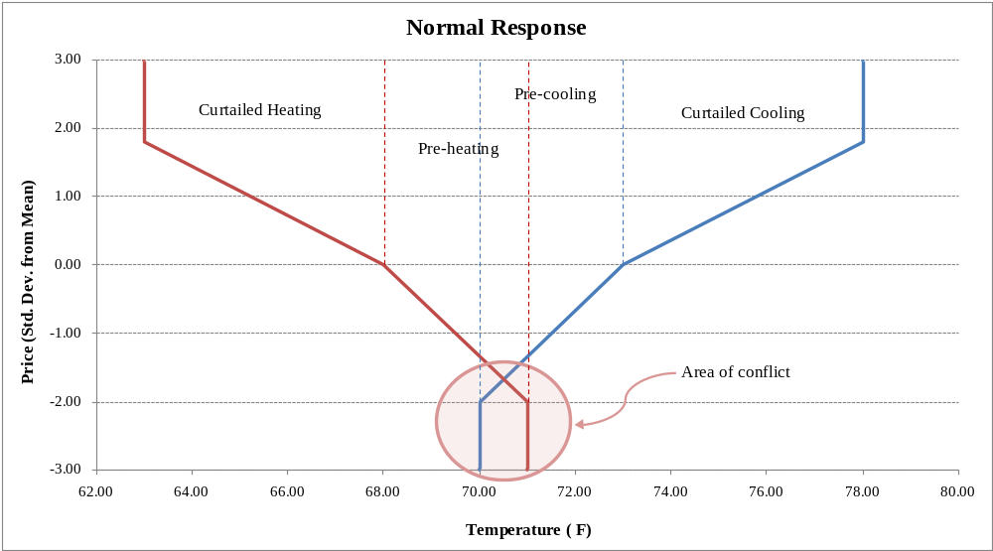
Controller Objects – Double Ramp
Normal action could cause conflicting pre-cooling and pre-heating states
DOUBLE_RAMP provides two means for resolving this conflict (deadband and sliding)

Slide 25
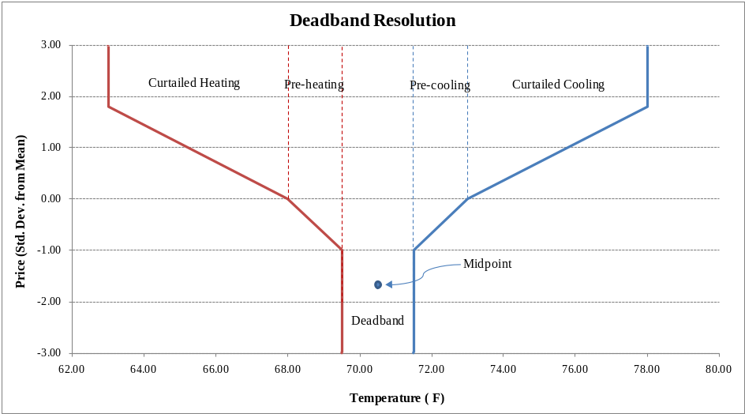
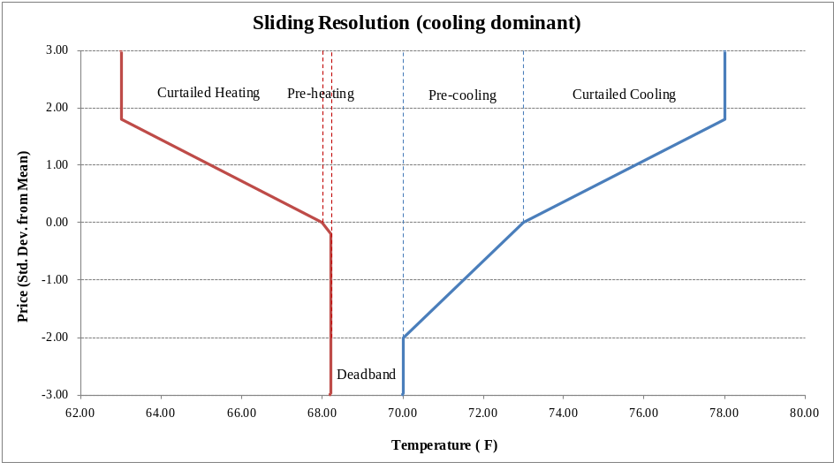
Controller Objects – Double Ramp
deadband resolution essentially limits the range of the pre-cooling and pre-heating and determines an average amount.
sliding resolution determines which mode (heat or cool) was last used, and allows this to override the other.

Slide 26
Controller Objects
object passive_controller {
string control_mode; //RAMP, PROBABILITY_OFF, others are unfinished
string mean_observation_property;
string stdev_observation_property;
string expectation_object;
string expectation_property;
string observation_object;
string observation_property;
string parent;
string setpoint;
string base_setpoint;
string setpoint_property;
string state_property;
integer period[s];
enum distribution_type; //NORMAL, UNIFORM, EXPONENTIAL (PROB_OFF)
double comfort_level; //0-inf (PROB_OFF)
double range_low/high, ramp_low/high; //(RAMP)
}
Only responds to a signal (not just price) – does not bid into market.
Typically used in conjunction with stub_auction.

Slide 27
Exercises
Using the runtime object, “test”, located in the demo folder for this section:
  Create three buyers and sellers.
  Using schedules or players for the prices and quantities, create the various clearing cases with the bidding objects.
  Record the resulting market clearings.

Slide 28
Exercises
Using stubauction and a passive controller object with a Time-of-Use price signal, record the temperature setpoints for a single house.

